Slide 1
Installing Anaconda

Slide 2
Overview
This tutorial is laid out as follows:
What is Anaconda? Installing Anaconda on Windows Installing Anaconda on Mac Appendix

Slide 3
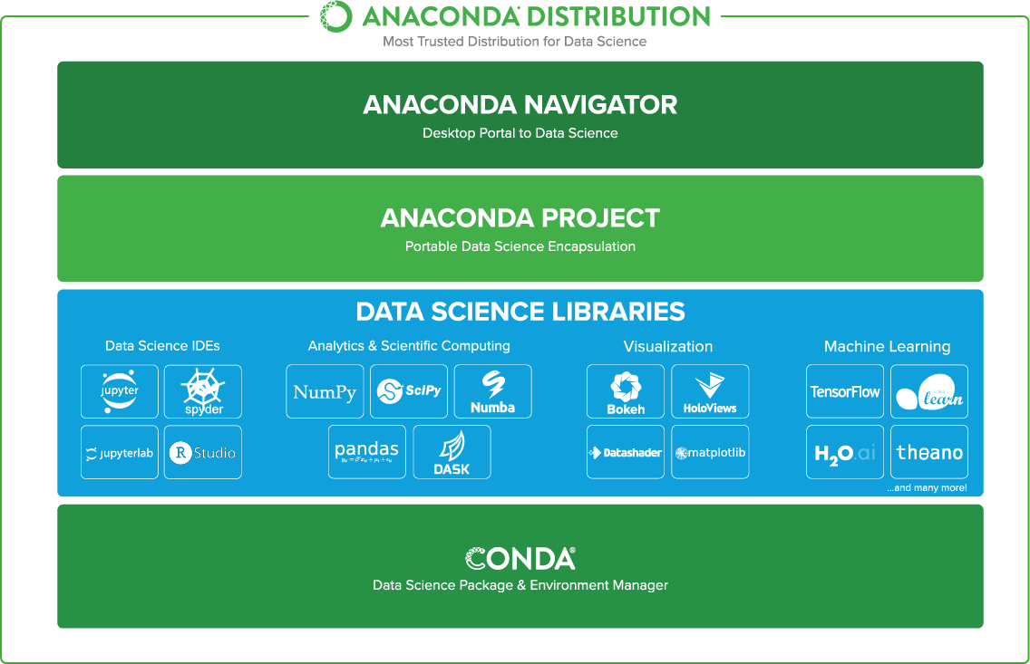

What is Anaconda?
The Anaconda Distribution contains (almost) everything that we will need when it comes to using Python to do Data Science.
To read up a little more, visit their website.

Slide 4
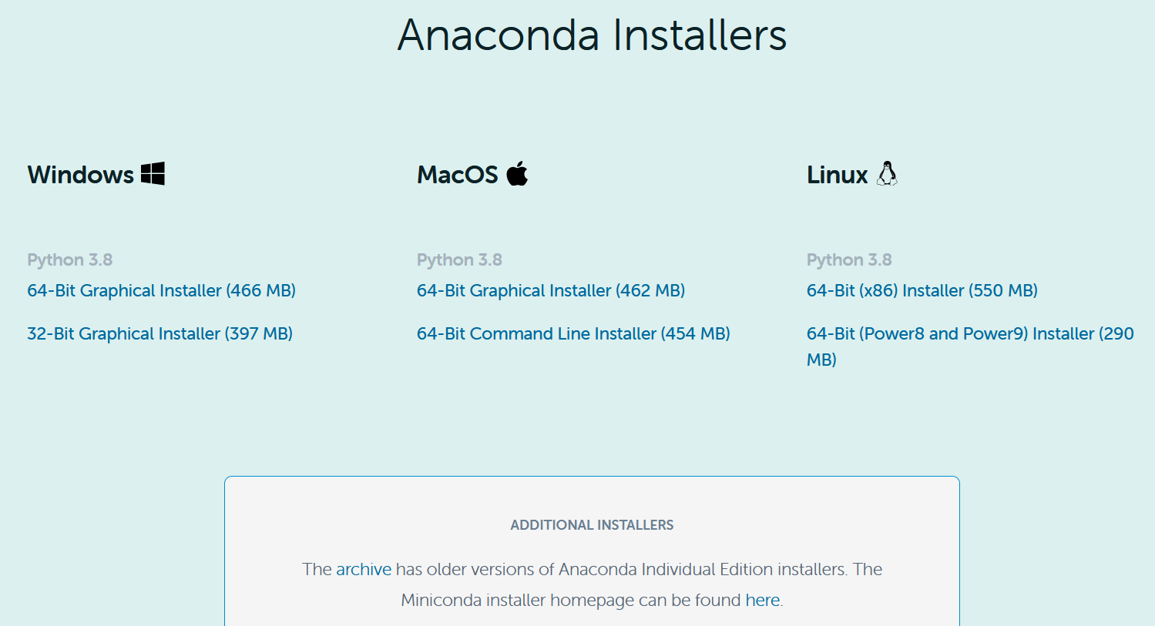
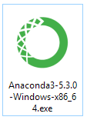
How to install Anaconda
The following slides depict
the installation process for
both Windows and Mac
Step 1
To install Anaconda, simply head to the Anaconda download page
Select your operating system and download the latest Python version
Run the Anaconda installer that was downloaded

Slide 5
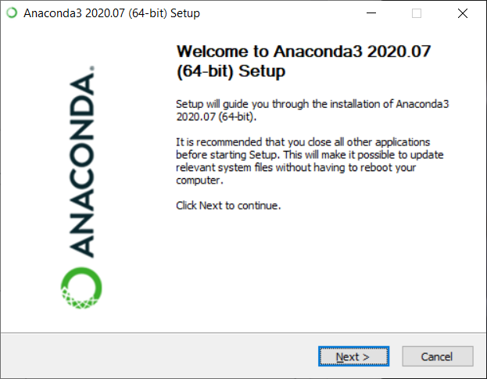
How to install Anaconda on Windows
Link to Mac OS installation instructions
Step 2
The Anaconda installer will step you through the installation process

Slide 6
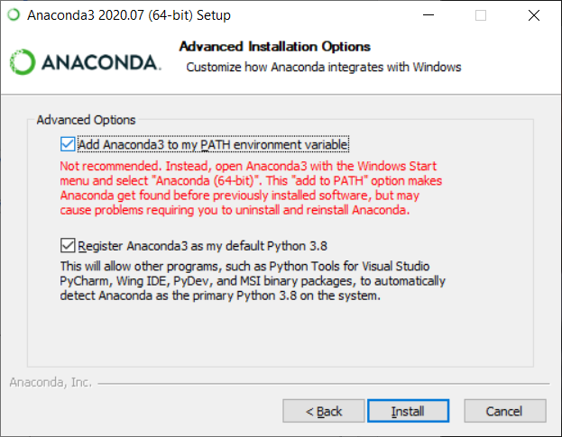
How to install Anaconda on Windows
Step 3
Select “Add Anaconda to my PATH environment variable” and “Register Anaconda as my default Python”

Slide 7
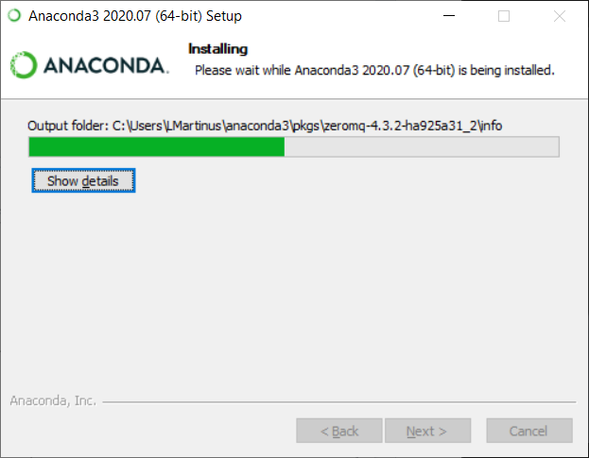
How to install Anaconda on Windows
Step 4
Wait for the installation to finish

Slide 8
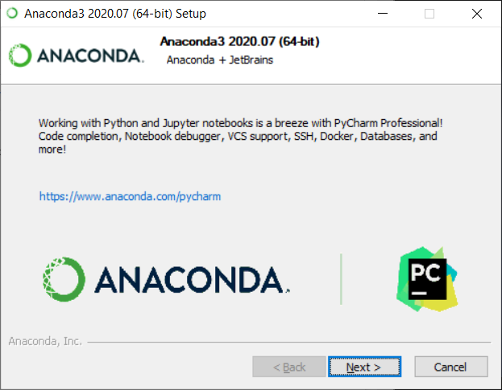
How to install Anaconda on Windows
Step 5
[Optional] Explore some of the recommended items

Slide 9
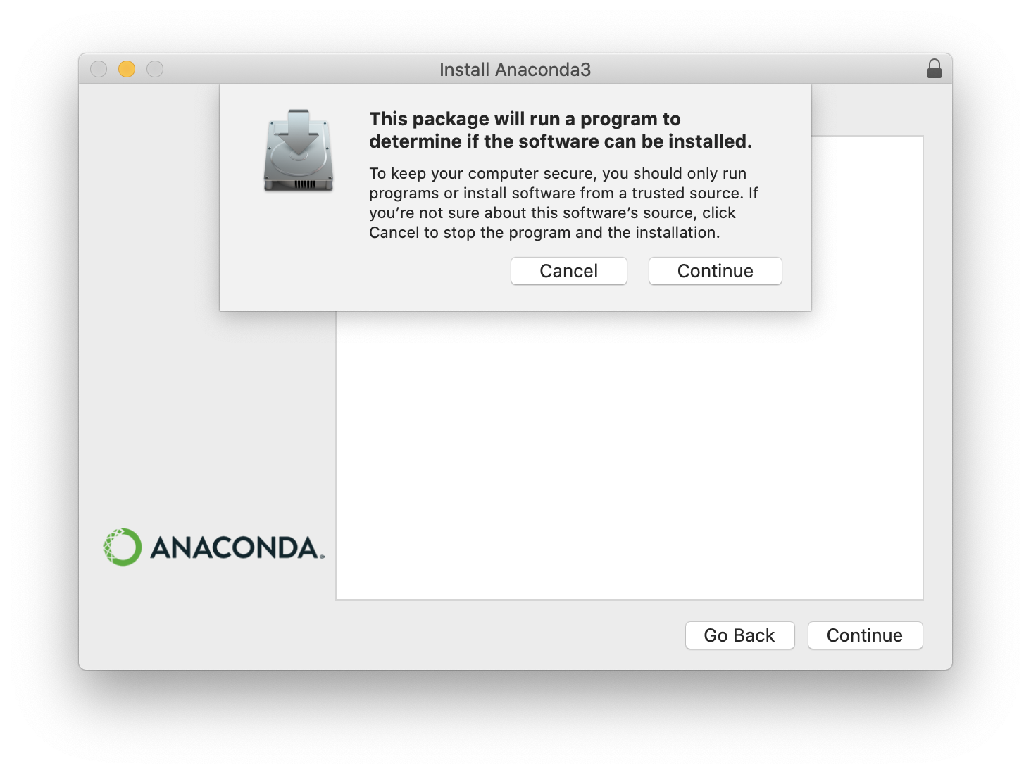
How to install Anaconda on Mac
Link to Windows installation instructions
Step 2
The Anaconda installer will step you through the installation process

Slide 10
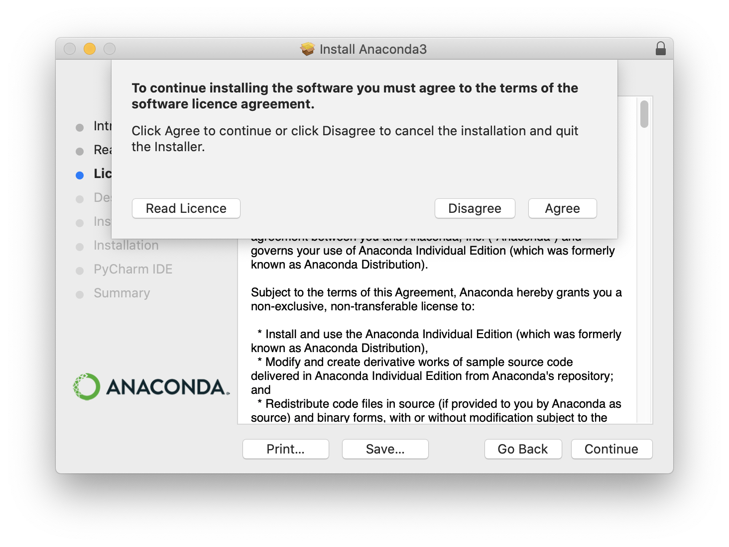
How to install Anaconda on Mac
Step 3
Agree to the terms of the software licence agreement

Slide 11
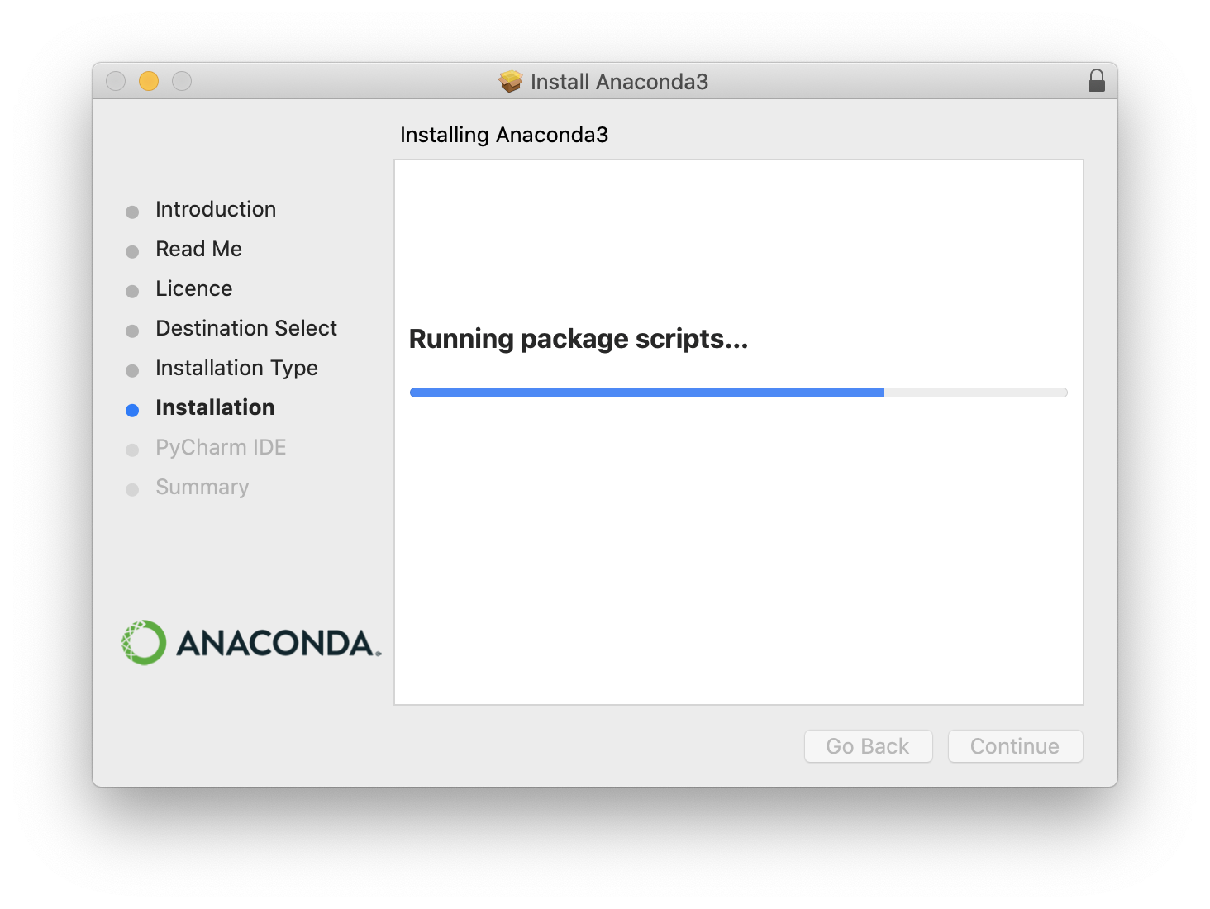
How to install Anaconda on Mac
Step 4
Wait for the installation to finish

Slide 12
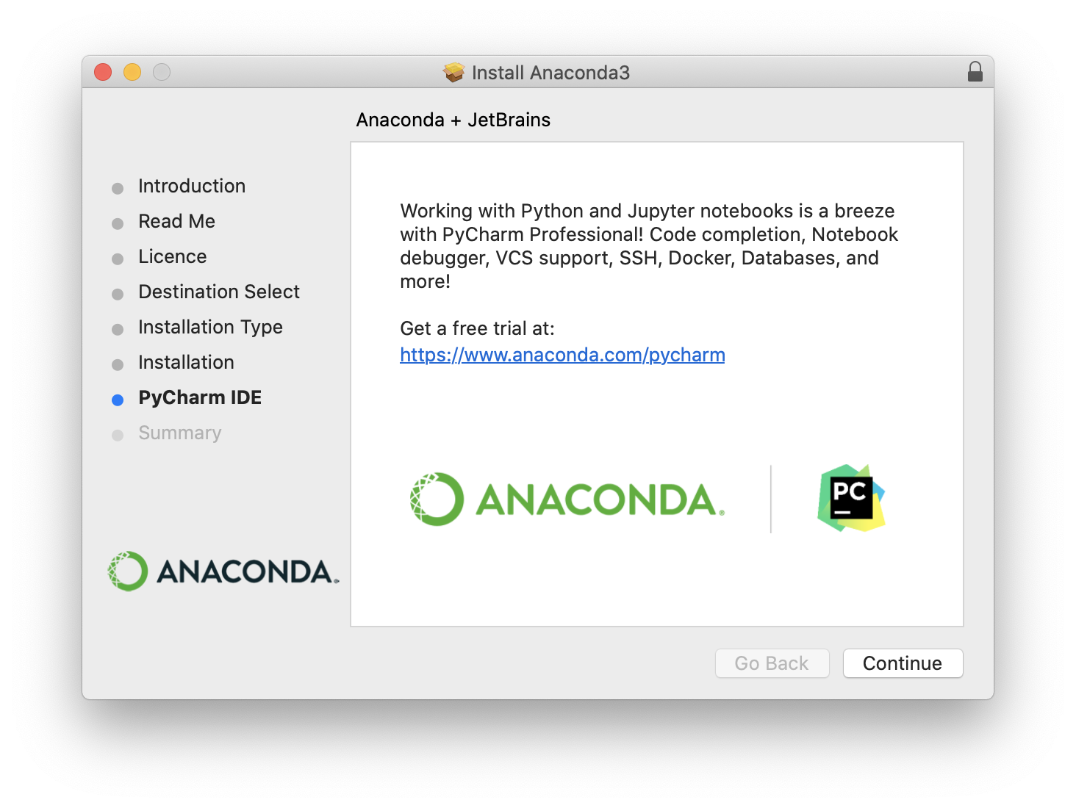
How to install Anaconda on Mac
Step 5
[Optional] Explore some of the recommended items

Slide 13
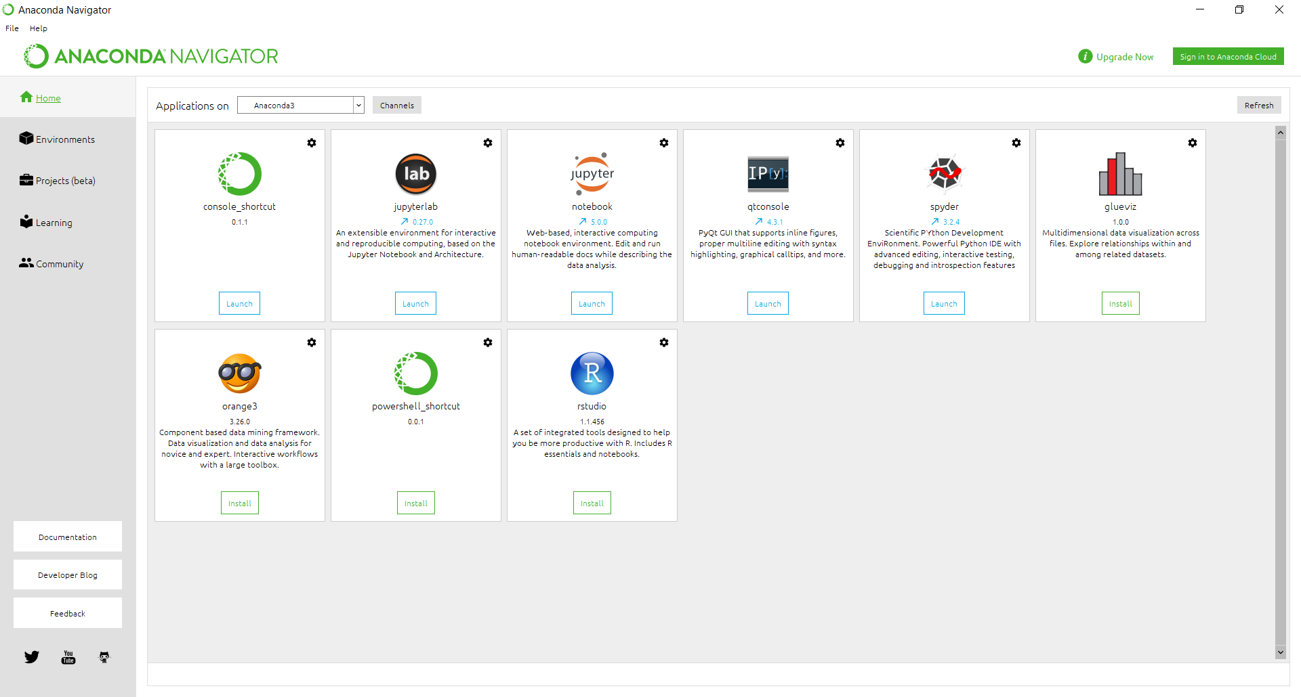
Conclusion
The application we will be
using most in this course
is Jupyter Notebook.
Ensure you have installed
this correctly and can
open a Notebook before
moving on.

Slide 14

Appendix
The following links may be useful for further learning around the content we've covered:
Anaconda
Getting started with Anaconda
Anaconda Miniconda Cheat Sheet for Data Scientists

